Slide 1
Google Classroom 101

Slide 2
Tips and tricks

Slide 3
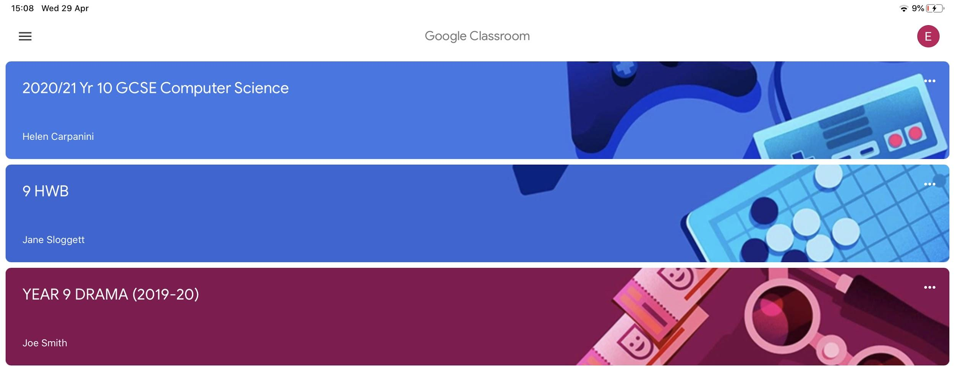
Tips and tricks
To keep track of what you need to do you can click the button that has 3 horizontal lines in the top left corner

Slide 4
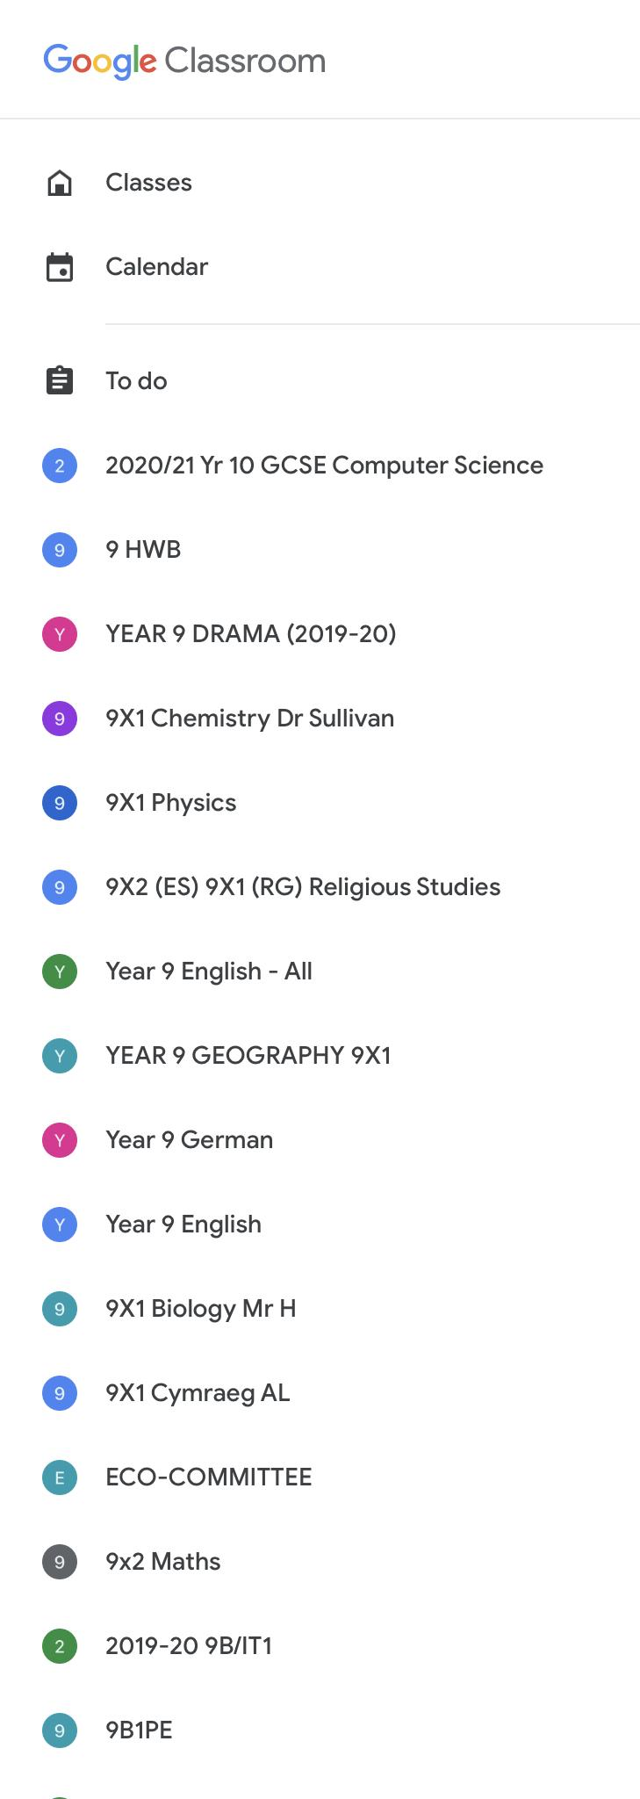
Tips and tricks
After you click that this menu will appear. Then click to do

Slide 5
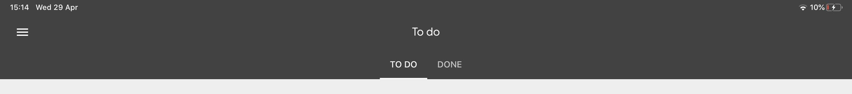
Tips and tricks
After you click that you will be presented with the “to do” page. This is where you can keep track of what your teachers assign you.

Slide 6
To do list
You can see the work that needs to be done and you can also click at the top of the list to see 'Done‘. As a parent/carer you will be able to see what has already been handed in.

Slide 7
Tips and tricks
This menu also has a calendar. This also shows your assignments.

