Slide 1
Google Classroom 101

Slide 2
Attaching files

Slide 3
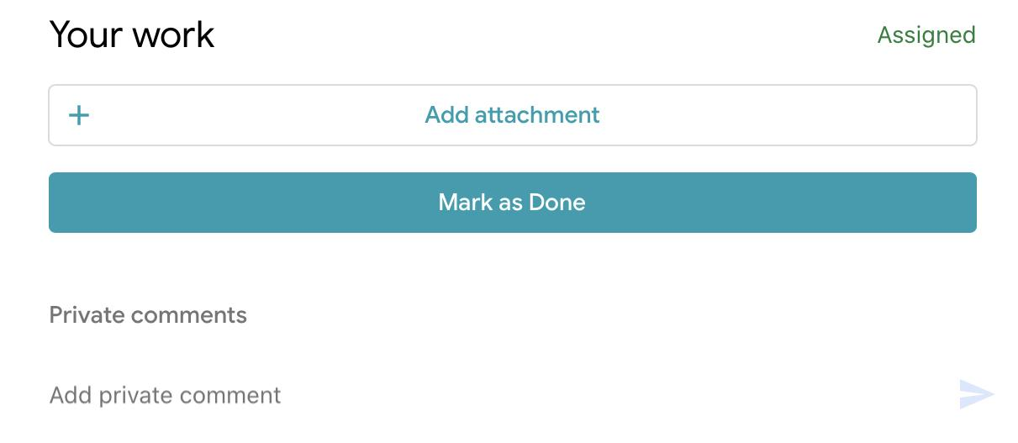
Attaching files
When you want to attach a file to an assignment you will be shown this menu.

Slide 4
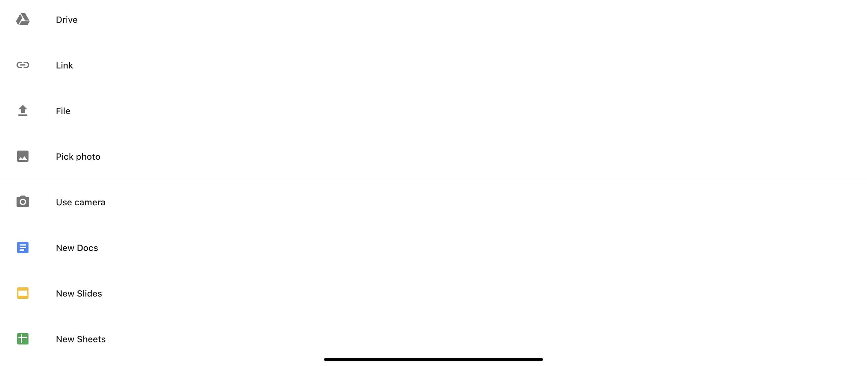
Attaching files
After you click that. You will be shown this menu

Slide 5
Attaching files
Then click one of the bottom buttons. If you need to make a word document click on the button with the blue arrow pointing to it. If you need to make a PowerPoint click on the button with a yellow arrow pointing to it.

Slide 6
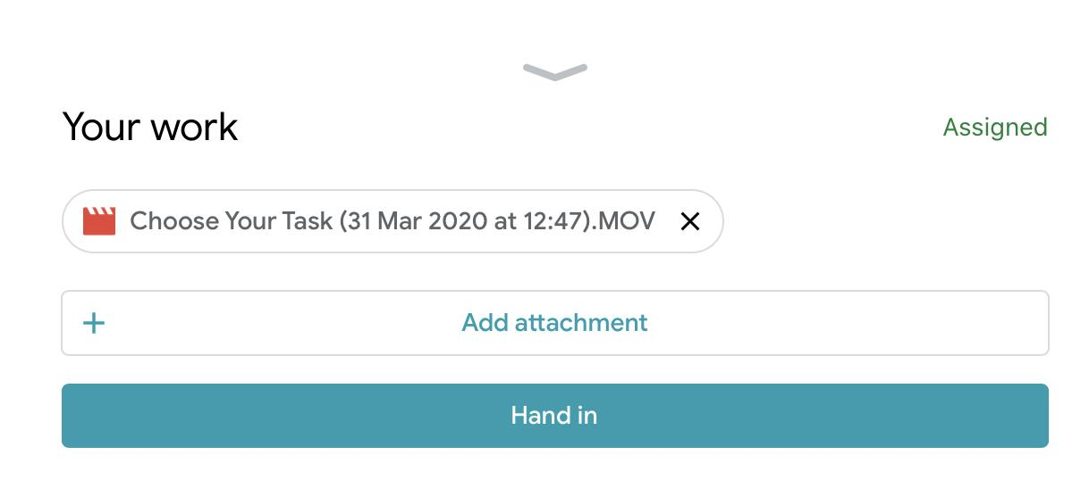
Attaching files
Once your work is complete your screen should look something like this. Click the hand in button to submit your work.

Slide 7
Attaching photos

Slide 8
Attaching photos
If you are on a phone or tablet you can use your camera to take a photo of your work by pressing on this button.

Slide 9
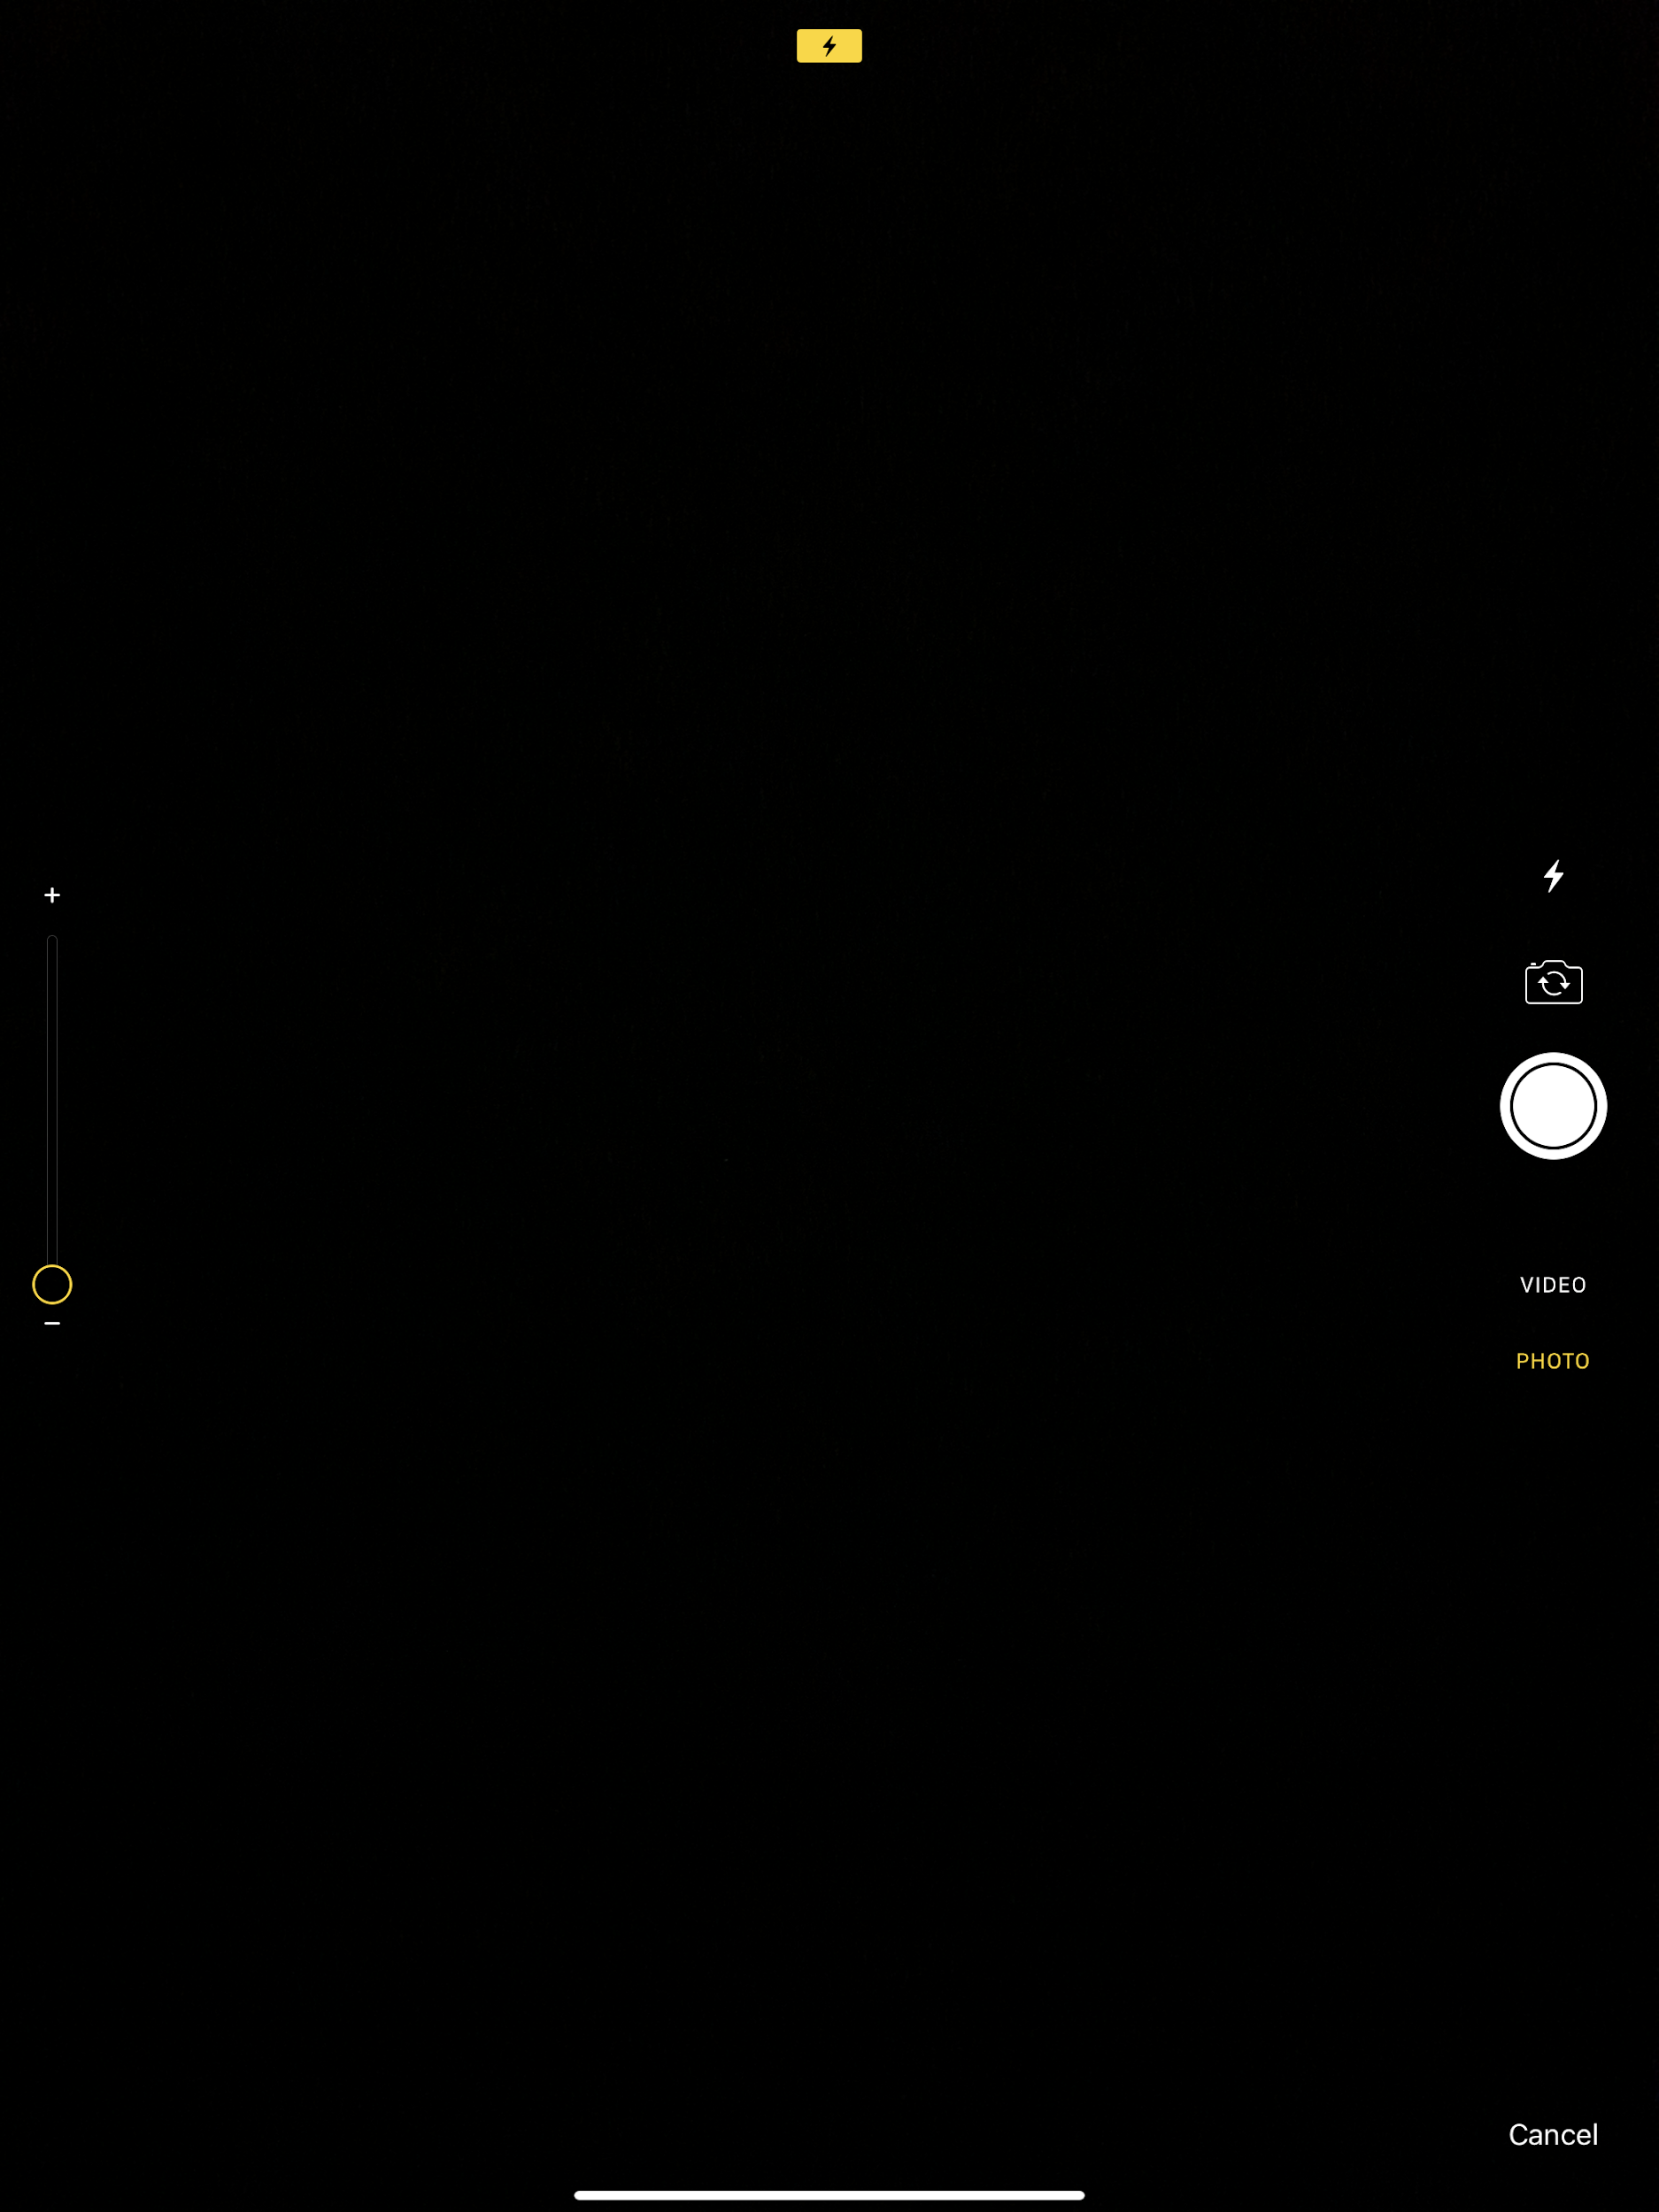
Attaching photos
Once you click that you will be taken to your camera. Use this to take a photo of your work.

Slide 10
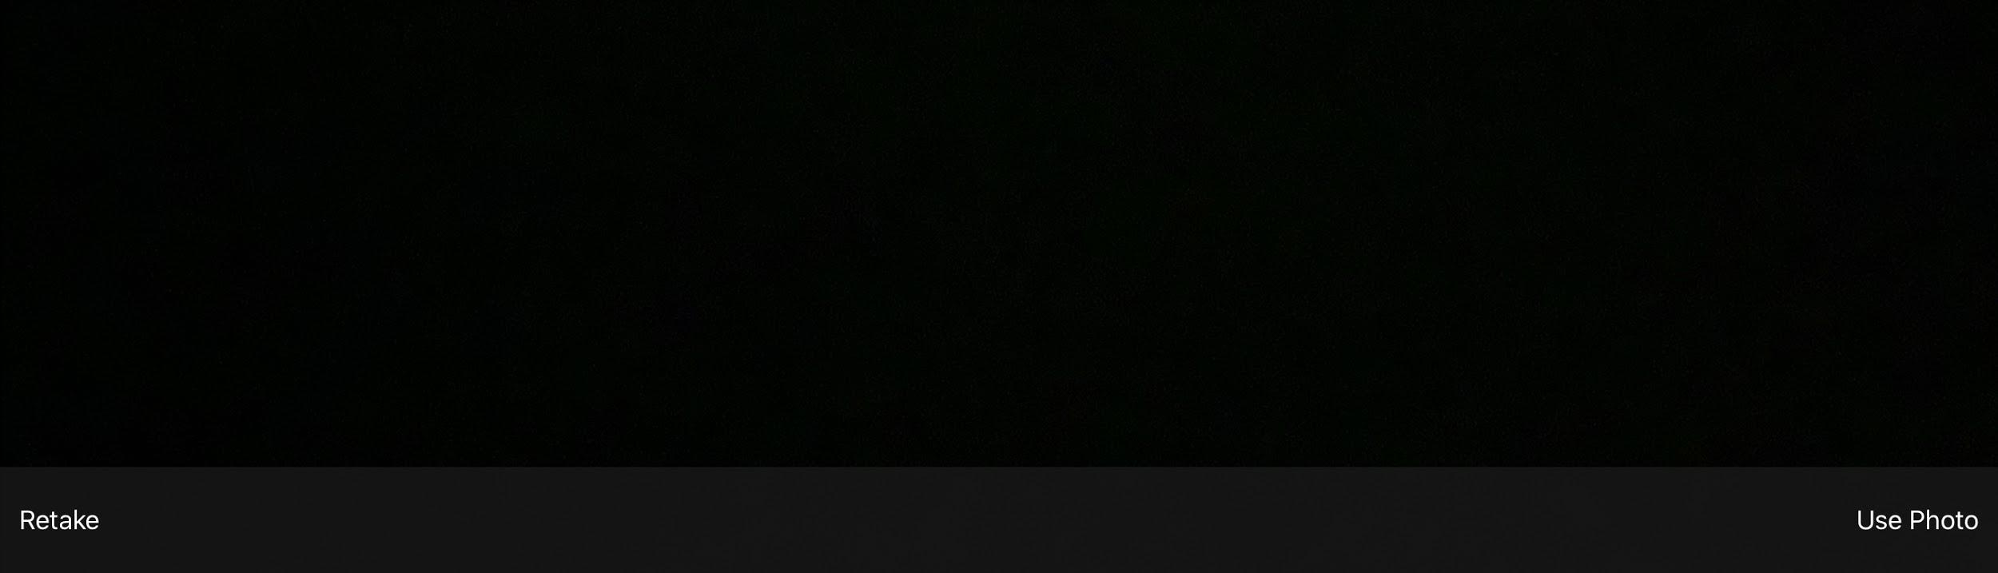
Attaching photos
Once you take a photo you will be shown this screen. Click use photo to use this photo. If you’re not happy with this photo click retake to retake your photo.

Slide 11
Attaching photos
Once you choose your photo you will be shown this menu. Click hand in to submit the photo.

