Slide 1
Google Classroom 101

Slide 2
Logging in

Slide 3
Laptop and computer

Slide 4
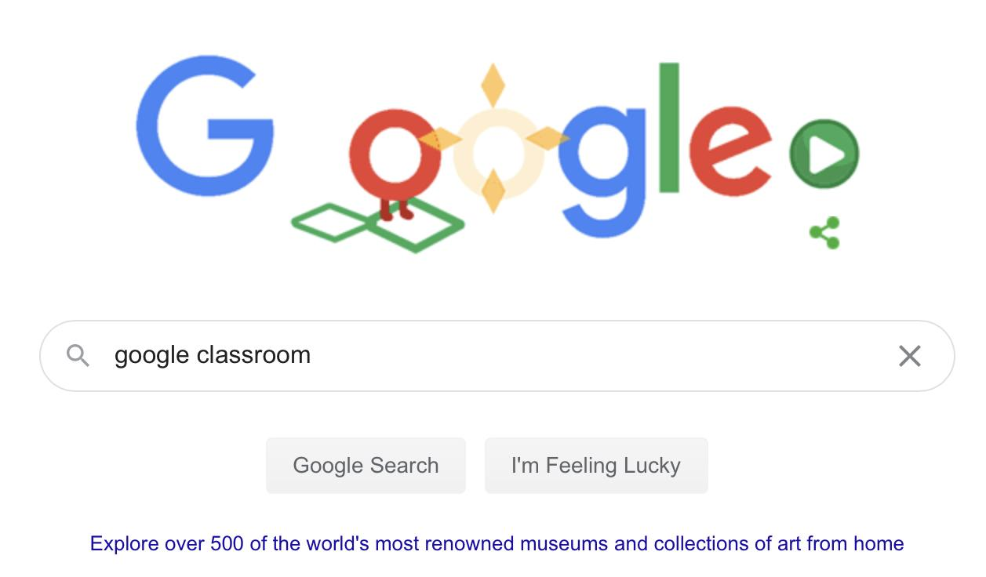
Laptop and computer
If you’re on a laptop or computer first go to google and type google classroom in the search bar.

Slide 5
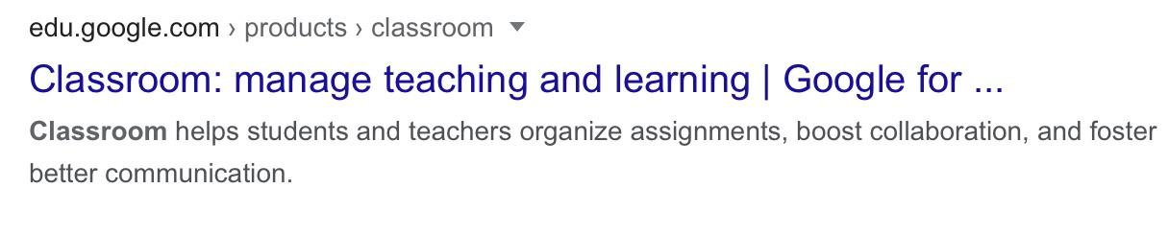
Laptop and Computer
Once you type google classroom into the search bar click the first link.

Slide 6
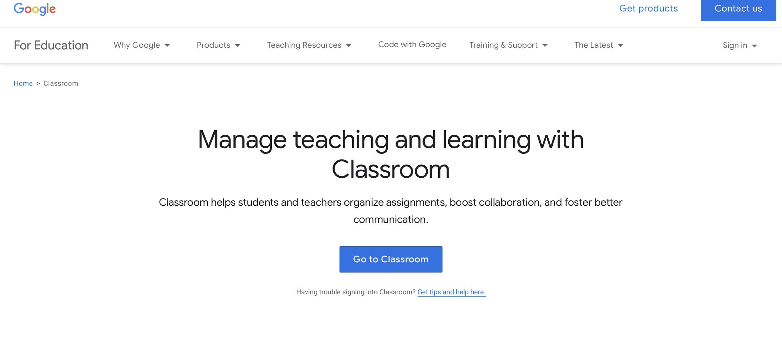
Laptop and computer
Once you click on the link click the sign in button in the top right corner.

Slide 7
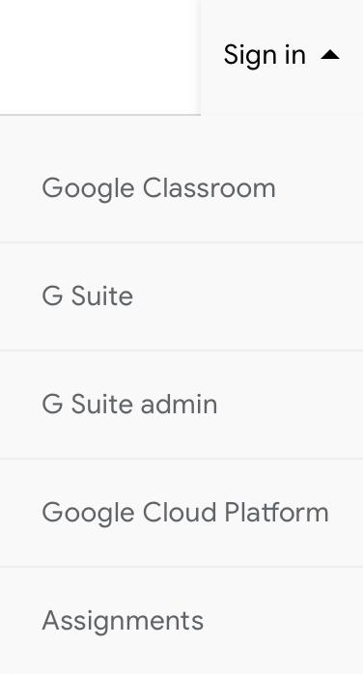
Laptop and computer
Once you click sign in this menu will appear. Once the menu appears click the google classroom button.

Slide 8
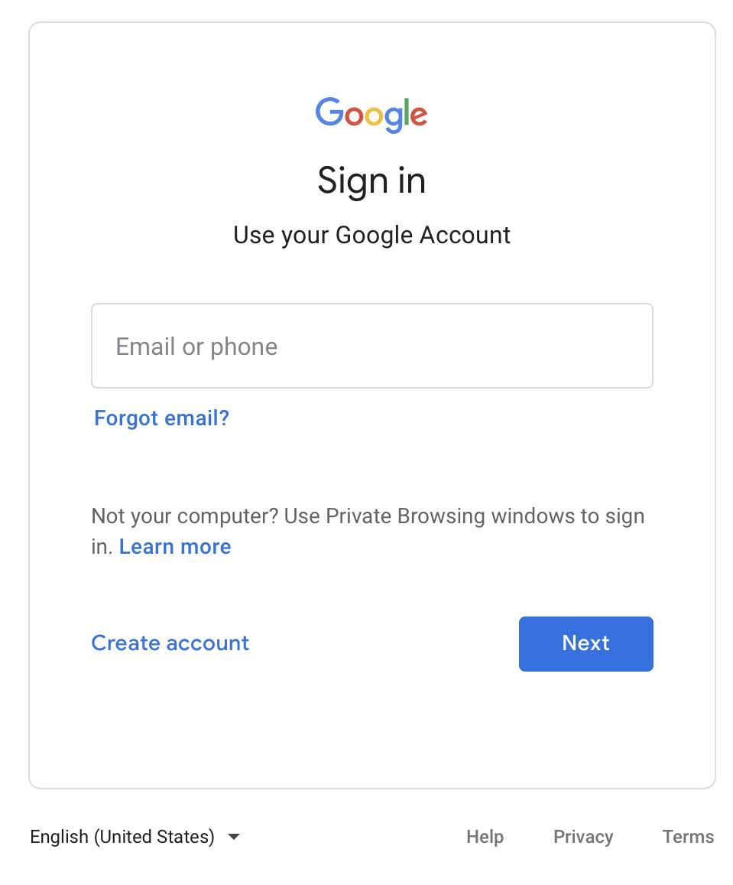
Laptop and computer
Once you click google classroom this menu will appear. After this menu appears put your @porthcawlschool.co.uk username in.

Slide 9
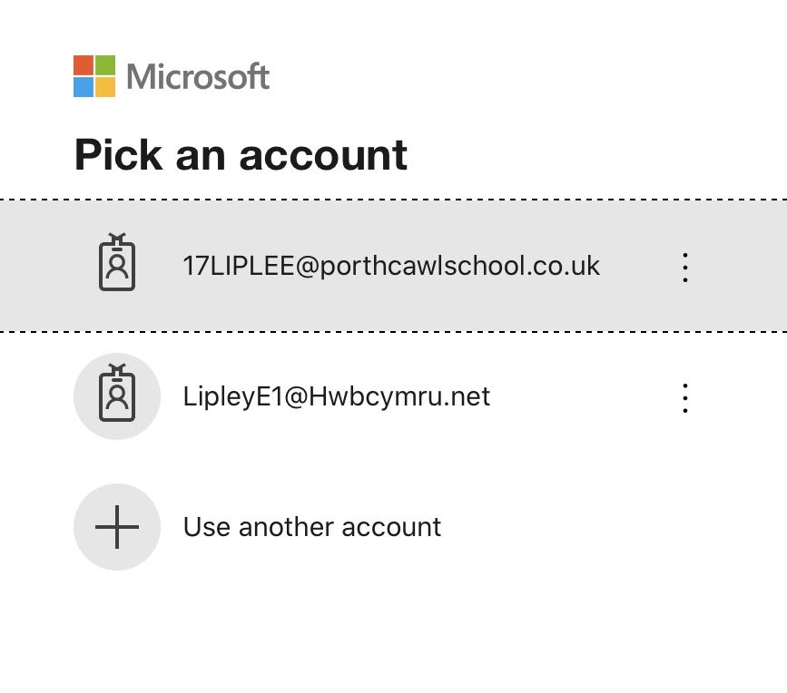
Laptop and computer
Once you sign in you will be shown this menu. Click on the account that has @porthcawlschool.co.uk on the end.

Slide 10
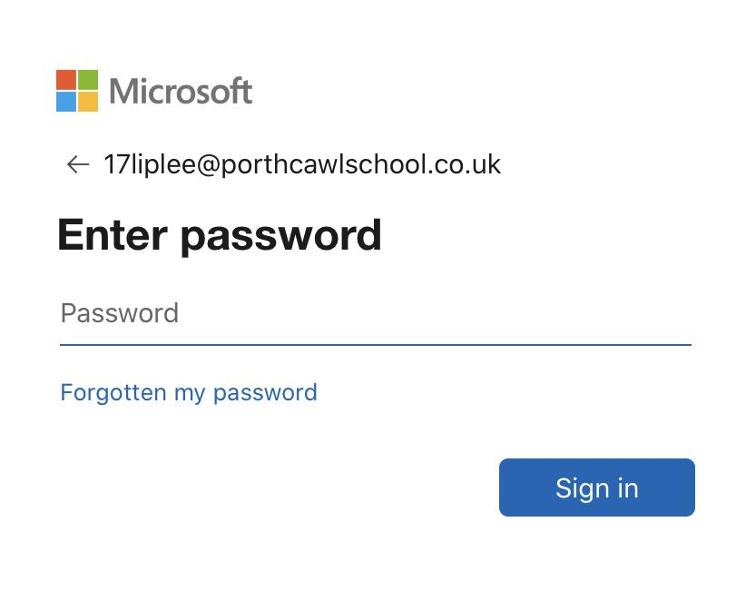
Laptop and computer
Once you put your username in, you will be asked to put your password in.

Slide 11
Laptop and computer
After you put your password in click on sign in.

Slide 12
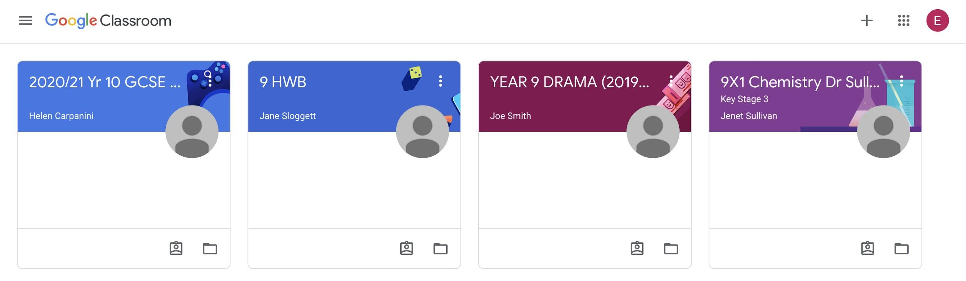
Laptop and computer
Once you sign in you will be taken to the dashboard. Now you are in google classroom.

