Slide 1
Google Classroom 101

Slide 2
Logging in

Slide 3
Phone and tablet

Slide 4
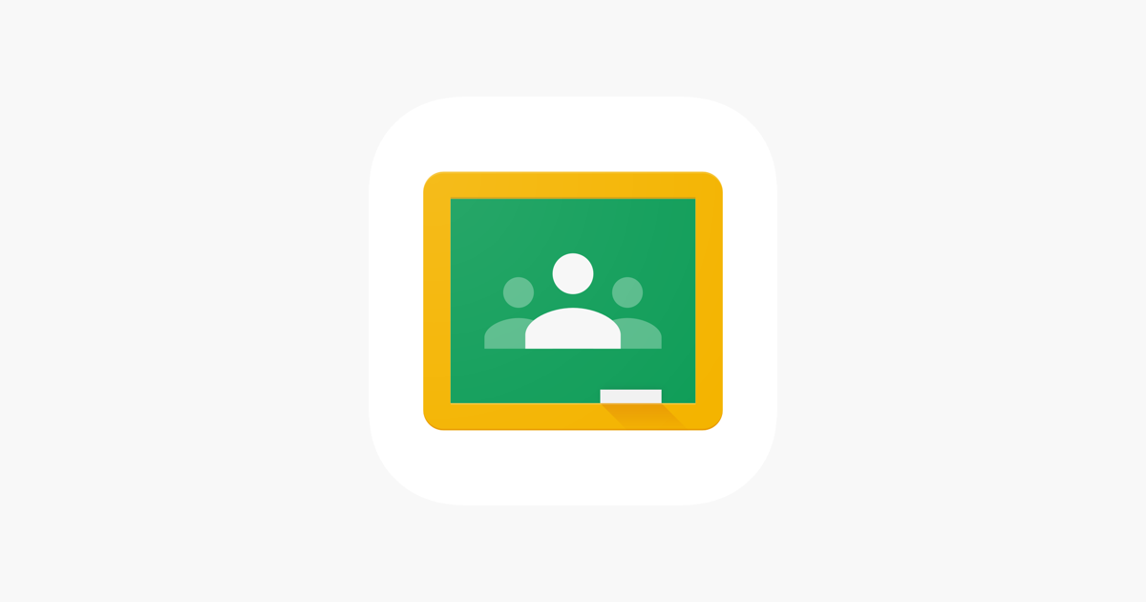
Phone and tablet
If you’re on a phone or tablet open the google classroom app as shown below

Slide 5
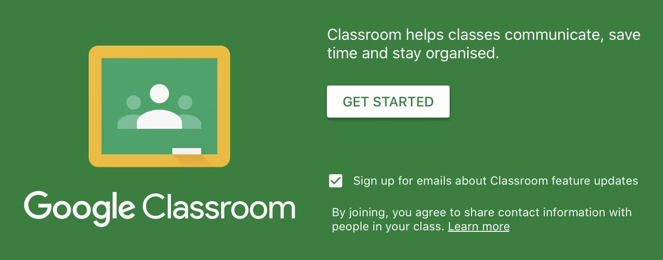
Phone and tablet
Once you open google classroom you will be shown this menu. Click on get started.

Slide 6
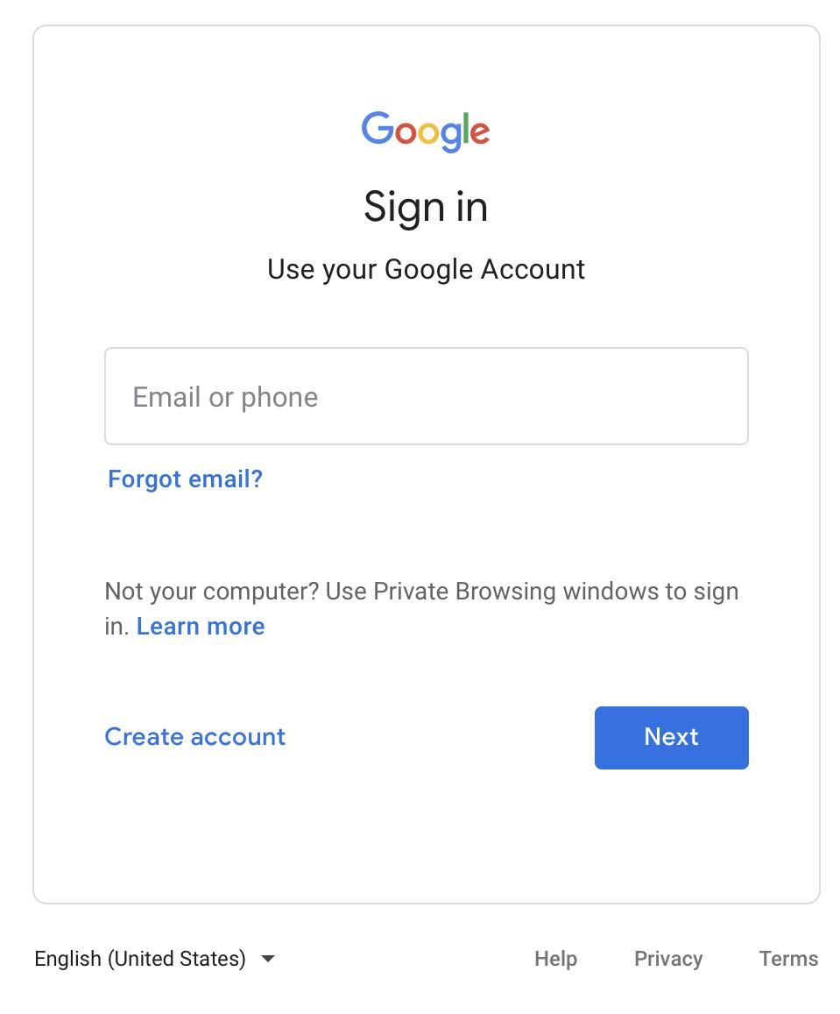
Phone and tablet
Once you click google classroom this menu will appear. After this menu appears put your @porthcawlschool.co.uk username in.

Slide 7
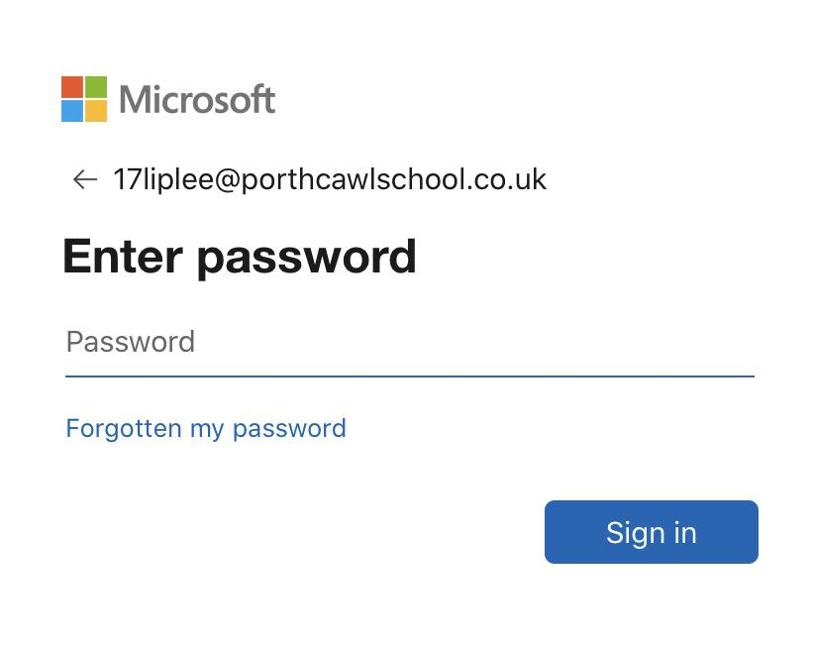
Phone and tablet
Once you put your username in, you will be asked to put your password in.

Slide 8
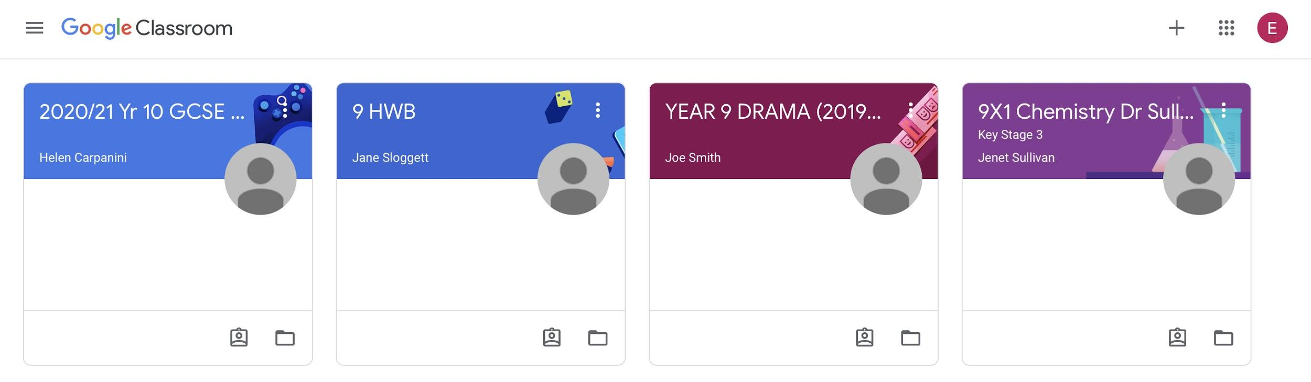
Phone and tablet
Once you sign in you will be taken to the dashboard. Now you are in google classroom.

