Slide 1

HOW DO I SUPPORT MY CHILD’S LITERACY?
‘It takes a whole village to raise a child.’

Slide 2
LITERACY AT SCHOOL AND AT HOME
At our School literacy is at the heart of everything we do. The development of literacy skills across all curriculum areas is vital. Effective literacy across the curriculum will develop students’ ability to:
Write for a variety of purposes and audiences
Collect information, organise ideas, draft, edit and write accurately
Access information and read fluently with understanding and comprehension
Speak and listen effectively, present information and extend and clarify their ideas and thinking
Confidence in literacy will also have an impact on their self- esteem, motivation and ability to work independently.
All staff are wholly committed to engaging students in their learning and are innovative in their approach to promoting reading and writing.
We are here to support you, as parents and carers, when it comes to ensuring your child has the best start to their study. We know it can be challenging to encourage your child to engage with literacy-based intervention outside of school so we have put together some documents and interventions to help support and challenge each and every child at Porthcawl Comprehensive School.
DID YOU KNOW?
Less than half of 8 to 16 year olds have read a book in the last month.
49% of children and young adults think that reading is boring.
Children who enjoy reading are 5 times more likely to be ‘above average’ in their Reading Assessment levels.
22% of children report that no one at home encourages them to read.
1 in 3 children do not own a book.
62% of boys do not enjoy writing and pupils at Key Stage 4 are the least likely to enjoy writing.
Research shows that the average length of a student’s contribution to a class discussion is 4 words.

Slide 3
From a whole school perspective...
TOP FIVE TIPS FOR SUPPORT:
Find a quiet spot that can be used for reading and homework.
Try to take time away from electronic devices such as mobile phones and computers.
Help to proofread - spellings, capital letters and punctuation.
Talk to your son/daughter about what they have read, studied and enjoyed.
We are here to help! If you need any help or feel your child is struggling with literacy, please contact us.
All reading lists are available on the school’s website
If you are wondering what your child’s most up-to-date reading age is, the NRT test will give an indication to this.
SPAG workbooks for each level of learning will be given as homework in Year 7 to be completed weekly.

Slide 4
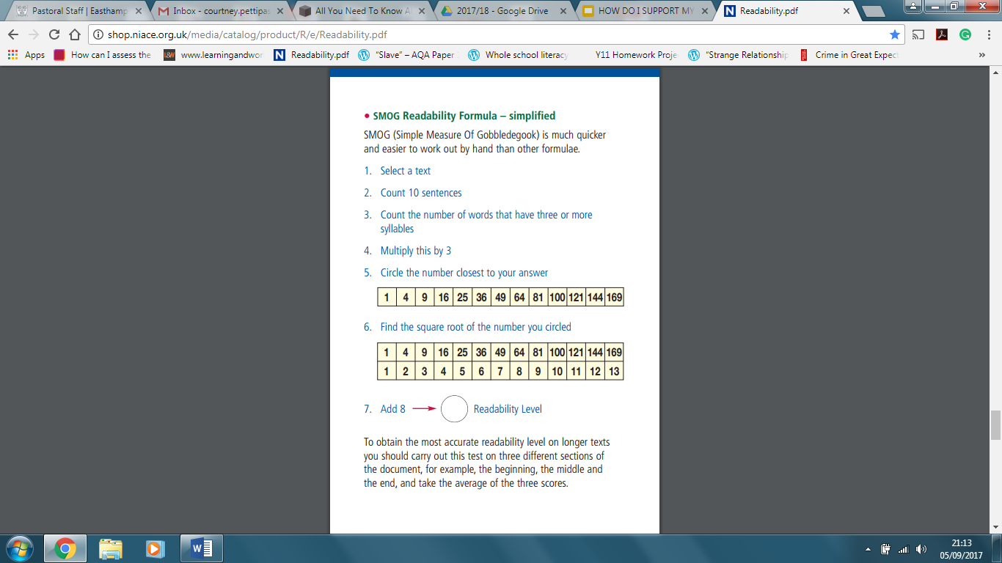
How to calculate the reading age of a text.

Slide 5
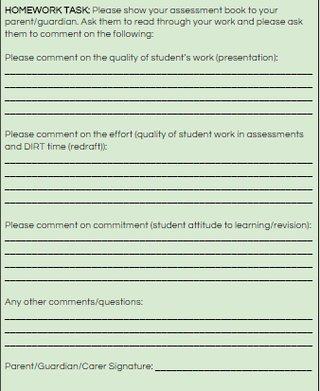
Ask for a baseline...
It is always helpful to see what your child has been doing in lessons as well as to gauge for yourself what his/her weaknesses might be and feedback from teachers.
Regularly check assessments and workbooks, discuss the work using prompts and fill in the parental engagement form to open a dialogue with teachers.

Slide 6
Answering in full sentences using the question focus in the answer.
Showing you are listening, e.g. looking at the speaker, asking follow up questions, using appropriate body language.
Listening attentively and be open to the views of others - you don’t have to agree, but you must be respectful.
Asking questions to further your understanding, e.g. ‘how’ and ‘why.’
Speaking clearly and confidently
Making sure your language is suitable for your language and context.
How can I help my child with their spoken language?

Slide 7
KEY STAGE THREE
How can I help my child with their reading?
Library Visits: Has your child ever visited your local library? Giving them the chance to experience this in the local community can boost their interest, enjoyment, and give them real world reading experience.
Exposure: It is extremely beneficial for pupils to have as much exposure to reading as possible so that they know that reading is an integral part of everyday life. Some things to try:
  Talk about reading – Ask them what they are enjoying reading at the moment and tell them about some of your favourite ever books.
  Make time to read together.
  If your son/daughter has younger brothers or sisters they could read with them .
  Don’t just read books – Try newspapers, magazines, comics or even the internet.
  Let them read what they are interested in – There are so many fantastic children’s authors now which you may not have heard of. If you are unsure whether a book is suitable, reading the blurb on the back and the first few pages should give you a clearer picture as well as calculate the SMOG age
Preparation: You can help to ensure that your child is well prepared for the reading initiatives currently taking place in school by making sure they have a reading book with them every day.
Rewards: Ensuring that reading has a high profile in your home will promote a healthy interest in books. Rewarding reading can also help reluctant readers to get into a good routine whilst also supporting avid readers to continue their good practice.
Obtain a FirstNews subscription at https://www.firstnews.co.uk/

Slide 8
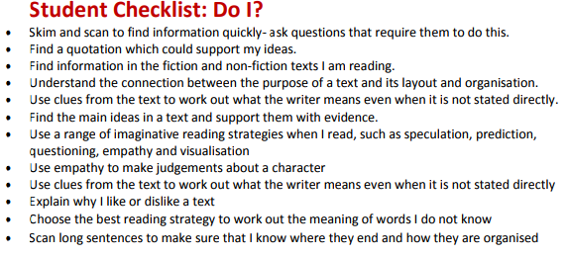
KEY STAGE THREE
To improve reading use the following student checklist for reading:
HELPFUL LINKS:
What Should I Read Next? www.whatshouldireadnext.com
BBC Bitesize: http://www.bbc.co.uk/education/subjects/z3kw2hv
Find a selection of books:
www.lovereading4kids.co.uk/
Carnegie Award Shadowing:
http://www.carnegiegreenaway.org.uk/shadowing.php
If your child has difficulty in following the words on the page, a ruler is a helpful tool to follow line by line. Specialised coloured reading rulers can be found on Amazon or in local stationery shops or ask an English teacher to provide one.

Slide 9
KEY STAGE THREE
How can I help my child with their writing?
http://www.bbc.co.uk/bitesize/ks3/english/writing/
Build a climate of words at home. Go places and see things with your child, then talk about what has been seen, heard, smelled, tasted, touched. The basis of good writing is good talk, and younger children especially grow into stronger control of language when loving adults -- particularly parents -- share experiences and rich talk about those experiences.
Let children see you write often. You're both a model and a teacher.
Be as helpful as you can in helping children write. Talk through their ideas with them; help them discover what they want to say. When they ask for help with spelling, punctuation, and usage, supply that help.
QUESTIONS TO ASK YOUR CHILD:
What is the purpose of your writing?
Is there a more ambitious word you could use here?
Have you put the full stop and comma (etc.) where it should go?
Who is your audience?
What other types of punctuation could you use here?
What type of text is this?
What was the feedback on your last piece of writing?

Slide 10
KEY STAGE THREE
How can I help my child with their writing?
Provide a suitable place and notebook for children to write. A quiet corner is best, the child's own place, if possible. If not, any flat surface with elbow room, a comfortable chair, and a good light will do.
Encourage (but do not demand) frequent writing. Be patient with reluctance to write.
Praise the child's efforts at writing. Forget what happened to you in school and resist the tendency to focus on errors of spelling, punctuation, and other mechanical aspects of writing.
If length is a problem draw a box on the page and ask child to write enough to fill the box. Add to the box as necessary.
Be alert to occasions when the child can be involved in writing, for example, helping with grocery lists, adding notes at the end of parents' letters, sending holiday and birthday cards, taking down telephone messages, writing notes to friends, helping plan trips by writing for information, drafting notes to school for parental signature, writing notes to letter carriers and other service persons, and preparing invitations to family get-togethers.

Slide 11
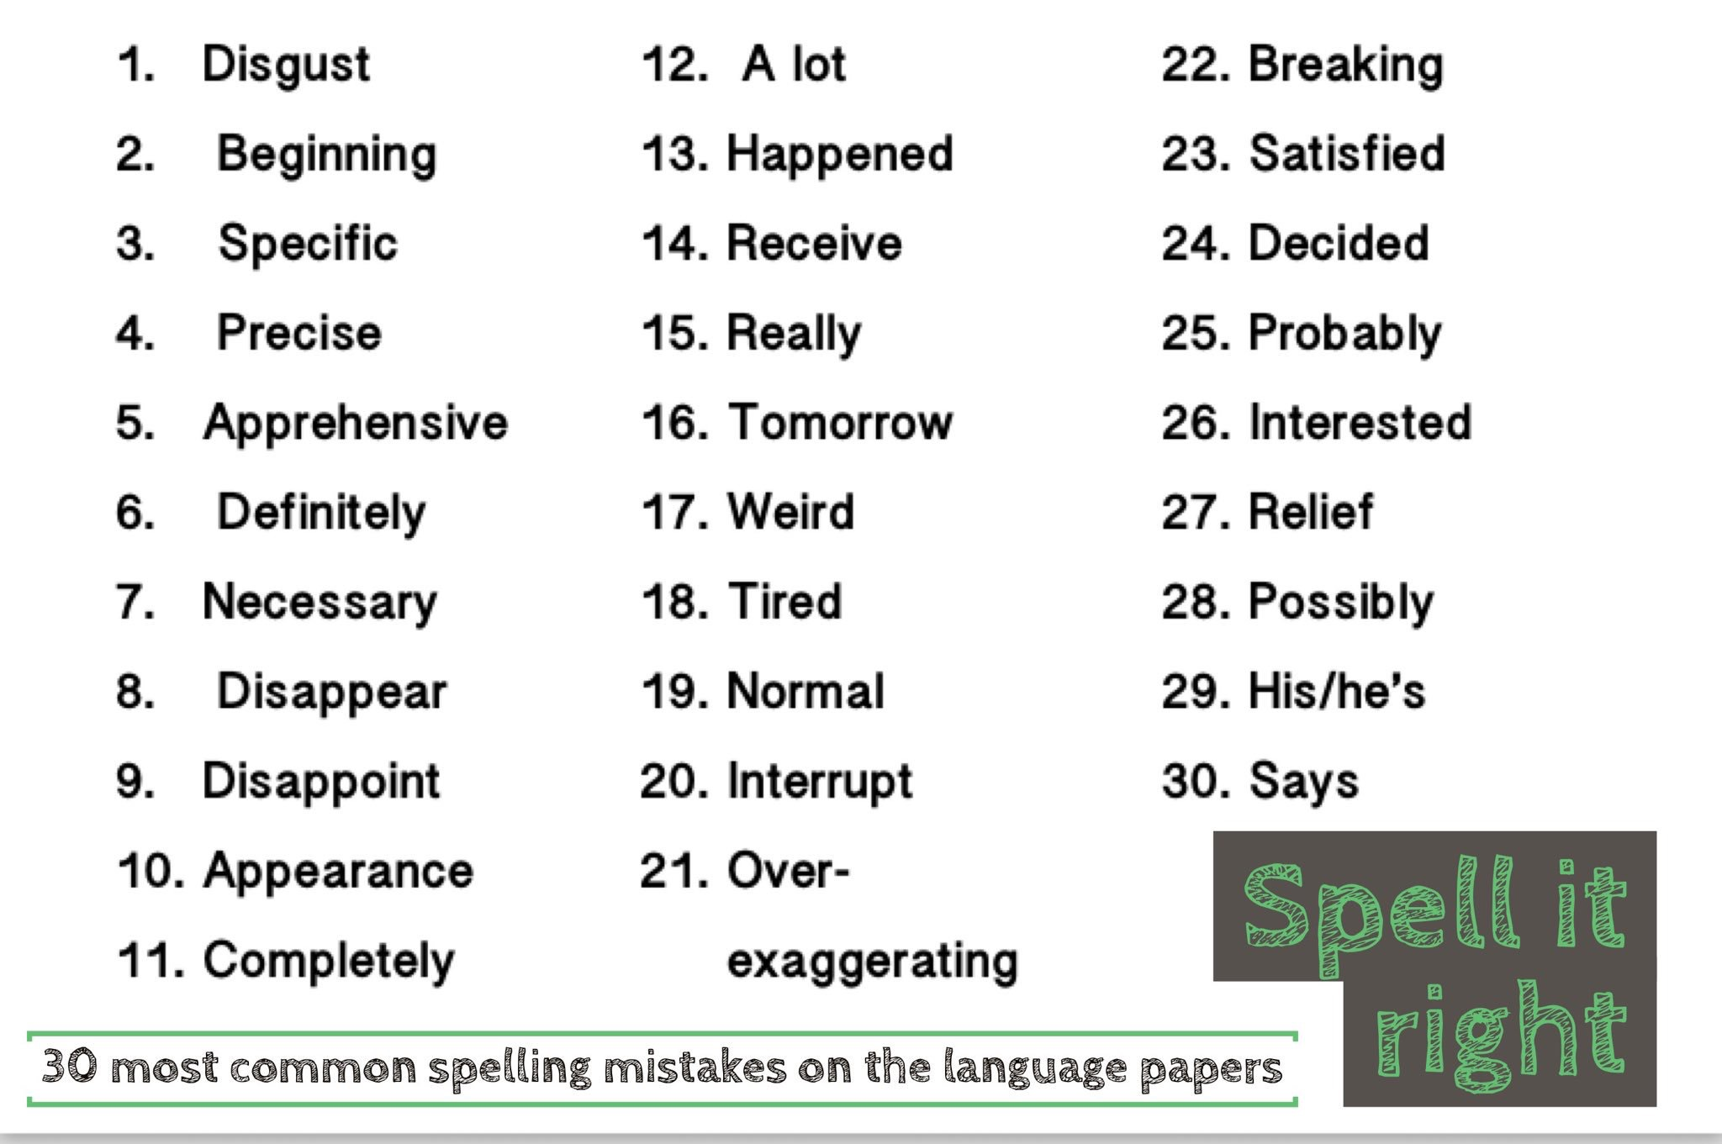
THINKING BEYOND KS3
In looking at examiners’ report from this year it became apparent that keywords were continuously misspelled.
These 30 words need to be embedded in your child’s vocabulary.

Slide 12
THINKING BEYOND KS3
-quesions to support literacy:
What is the relevance of this word?
Who is this character and why is he/she significant?
What do you think is going to happen?
How will this support your knowledge for your exam?
Can you create an example or real-world scenario for me based on what you have read?
How can I help make this information stick?
Can you use a more ambitious word here?
What other forms of punctuation could you use?
If I draw a box in your workbook can you fill it with writing?
On a scale of 1-10 what is the amount of effort you have put into this piece of homework?

Slide 13
THINKING BEYOND KS3
support your child with reading.
As your son/daughter prepares for their GCSE’s in Years 9/10/11 they will be asked to read/write more extended texts.
Research findings: reading means achieving Recent research into the reading skills of 15 year olds across the world found that children who are more interested in reading do better at school than those who don’t read for pleasure. The study also found that parents who talk to their children about books, TV programmes and films help to keep their children interested in reading. Having books, newspapers and magazines around at home also made a difference to how interested children were in reading. (DfE)
Extended reading and independent study of subjects that your child is interested in make for more well rounded and focused analysis in coursework and exams.

Slide 14
THINKING BEYOND KS3
-how do I help at home?
Collect newspaper articles about topics your child is studying.
Read together if your child is having problems with reading in a particular subject.
Read with them - you could both do the read six books in 6 weeks challenge
Speak to your child’s subject teacher, to see if there is anything that they could read that would help their studies or that would help them enjoy a topic.
Talk about everyday topics, encouraging your child to use the technical terms they are learning at GCSE.
Look up technical words that you or your child don’t recognise from their work in a dictionary or on the internet and make it your word of the day.
“I was really worried about my son as he used to tell me that he hated reading. One way I could get him to read was by buying car magazines as a treat. I found out you could borrow magazines for free from the library so now he goes down there as well.”
“It’s easy to forget how much reading you do every day. I make sure my kids realise it is a part of my life by getting them involved when I can – like cooking using a recipe, making a shopping list or looking at the paper to see where we are in the league!”

Slide 15
How can I help my child with their writing?
http://www.bbc.co.uk/schools/gcsebitesize/english/writing/
Build a climate of words at home. The basis of good writing is good talk, and younger children especially grow into stronger control of language when loving adults -- particularly parents -- share experiences and rich talk about those experiences.
Be as helpful as you can in helping children write. Talk through their ideas with them; help them discover what they want to say. When they ask for help with spelling, punctuation, and usage, supply that help.
Encourage your child to read newspapers and respond in letter form to the opinion section or even online comments sections of news stories.
Provide a suitable place and notebook for children to write. A quiet corner is best, the child's own place, if possible. If not, any flat surface with elbow room, a comfortable chair, and a good light will do.
Sample exam papers are available from all exam boards and, at the very least, from your child’s teacher.
Ask your child what the difference is between a 4 mark question and a 20 mark question.
Set a timer and have your child try to answer questionS in full in allotted time (a minute per mark is a good guideline)

Slide 16
THINKING BEYOND KS3
How can I help my child with their writing?
Praise the child's efforts at writing. Forget what happened to you in school and resist the tendency to focus on errors of spelling, punctuation, and other mechanical aspects of writing.
If length is a problem draw a box on the page and ask child to write enough to fill the box. Add to the box as necessary.
Be alert to occasions when the child can be involved in writing, for example, helping with grocery lists, adding notes at the end of parents' letters, sending holiday and birthday cards, taking down telephone messages, writing notes to friends, helping plan trips by writing for information, drafting notes to school for parental signature, writing notes to letter carriers and other service persons, and preparing invitations to family get-togethers.
Extended creative writing tasks are available through the literacy page of the PCS website.
Students should also be familiar with the characteristics and requirements of text types in all facets of writing (homework included). These are also available through emailing your child’s teacher.

Slide 17
For further support please contact the Head of English, Media & Literacy Faculty rhaea.mahoney@porthcawlschool.co.uk or our Skills coordinator at leigh.kembery@porthcawlschool.co.uk
‘It takes a whole village to raise a child.’

