Slide 1
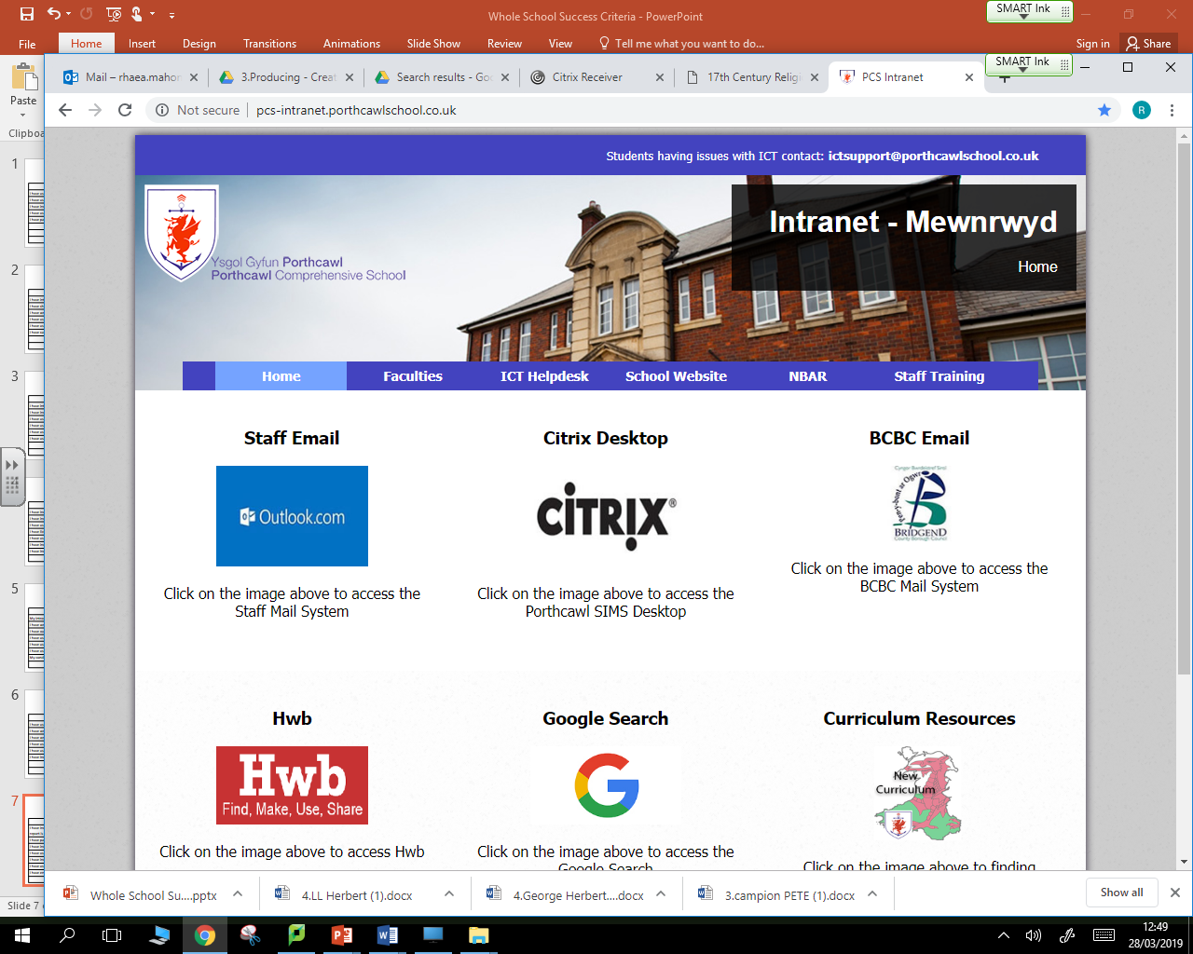

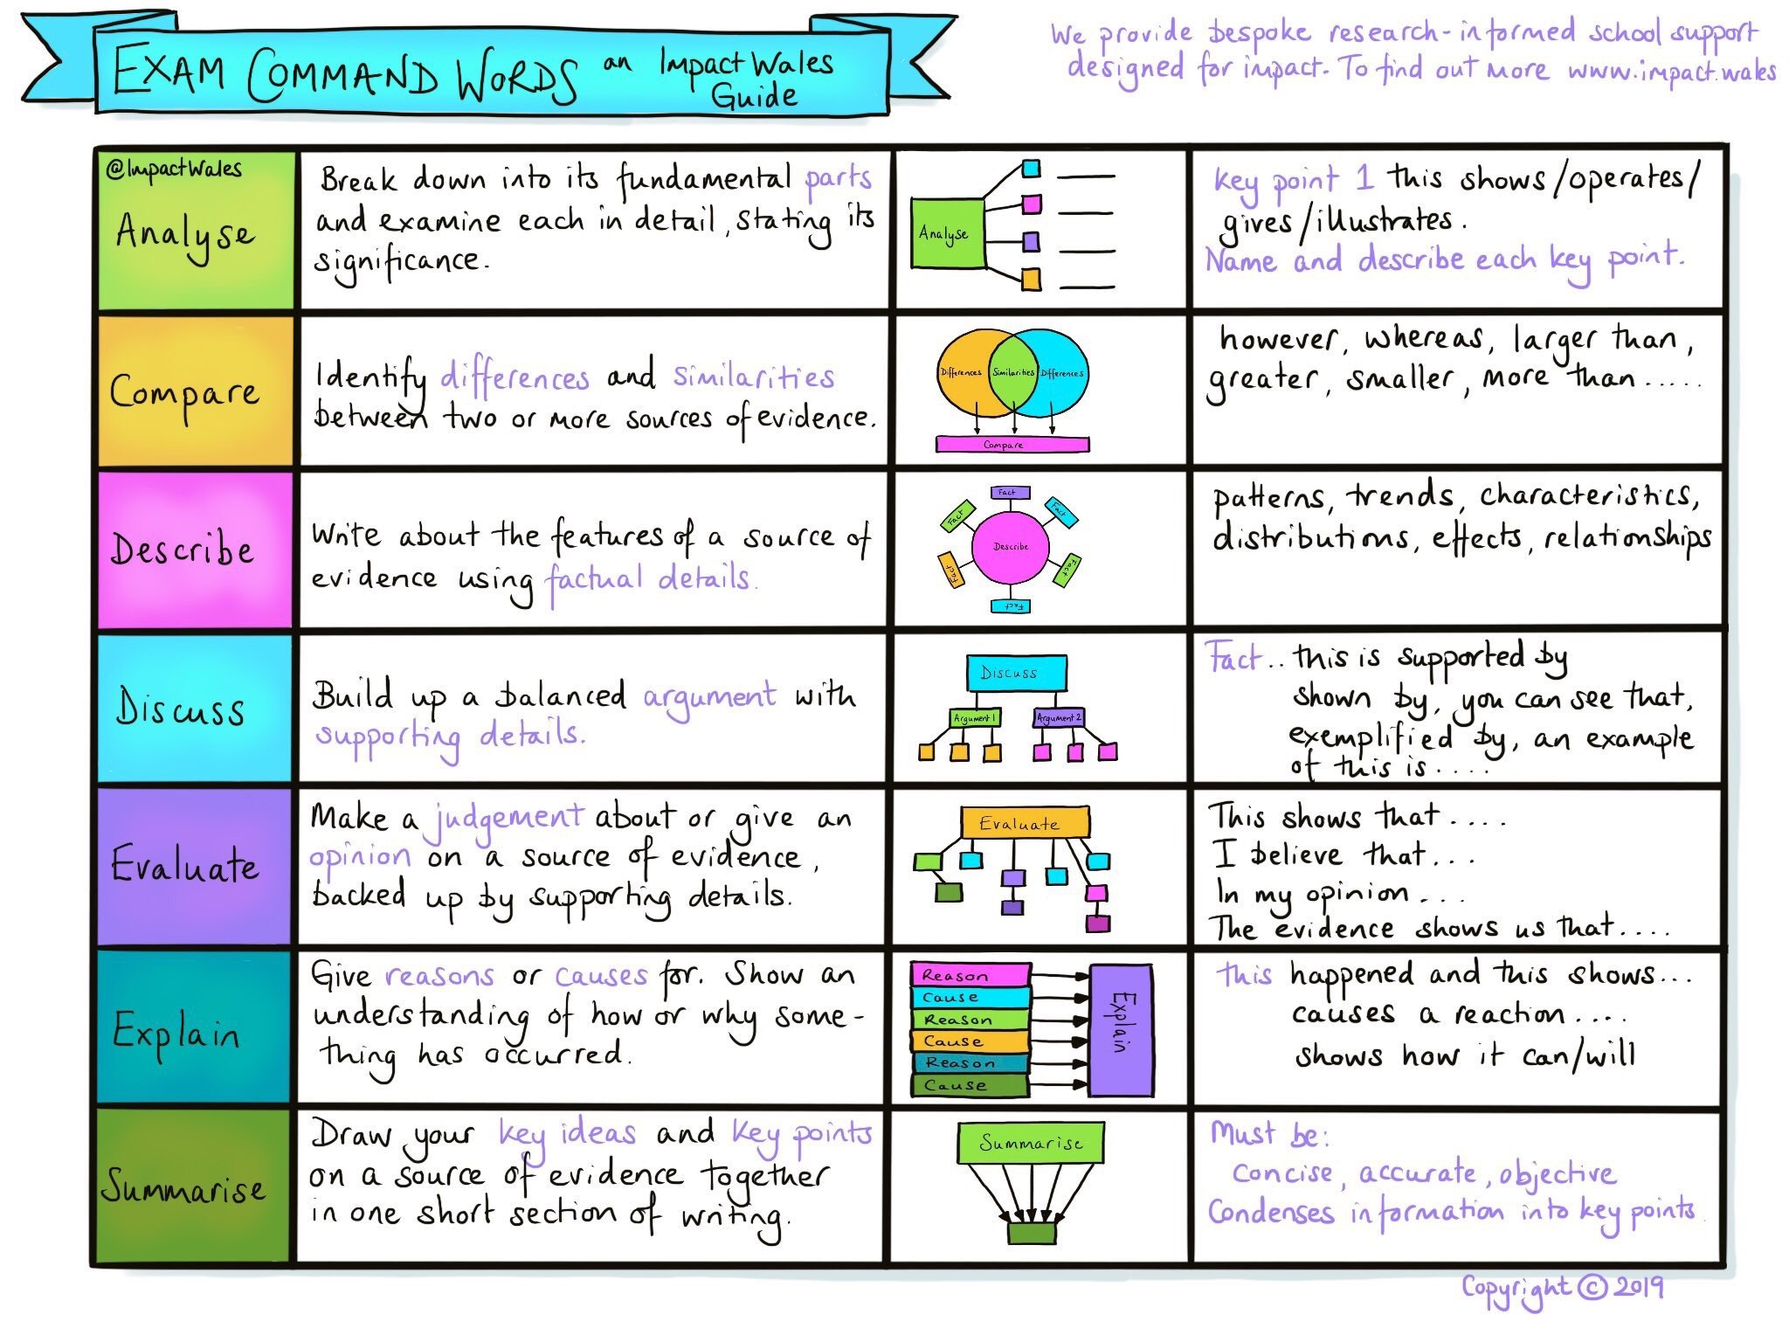
Writing to Discuss / Argue – Steps to Success
I have introduced the argument / discussion in the first paragraph.
I have shown both sides of the argument and remained objective.
I have written in the third person (he, she, it, they).
I have used connectives to structure the arguments and link ideas.
I have summarised the argument in the final paragraph.
Sentences are well-formed and appropriately varied in length and style. (Maybe using AP sentences for deliberate effect.) There are few if any spelling or grammatical errors.
*Argument writing would be more passionate than discursive writing which would be more restrained.

Slide 2
Writing to Discuss / Argue – Vocabulary
Connectives adding more information | Useful words for introducing opinions | Tentative sentence starters and phrases
A key long term cause of... The main reason... The main method of... To make matters worse... It is therefore reasonable to conclude... the fact that the deciding factor has become known as | There is much debate about whether... Many people would argue... The majority view is... However, a minority felt that... A further complication is.... Other sources suggest... Another issue to consider is... It is clear that.... It is worth considering... A key reason why... Research suggests that... The main advantage of... This means that... The main disadvantage of... | Perhaps the explanation for why... could perhaps have One probable explanation... It is worth considering... It would appear that... There is much evidence to suggest that...

Slide 3
Writing to Compare – Steps to Success
I have introduced the topic to compare in the first paragraph.
I have stated how things are similar and different using comparison connectives.
I have supported with evidence from the text.
I have stated clearly which text I am discussing and I have used connectives to structure the arguments and link ideas.
I have summarised the similarities and differences in the final paragraph.
Sentences are well-formed and appropriately varied in length and style. (Maybe using AP sentences for deliberate effect.) There are few if any spelling or grammatical errors.

Slide 4
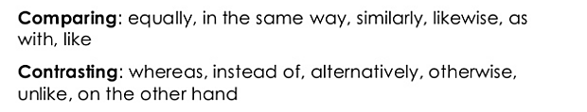
Writing to Compare – Vocabulary

Slide 5
Writing to Evaluate – Steps to Success
I have briefly addressed the topic to be evaluated in the first paragraph.
I have ensured each paragraph contains a key point which is discussed and evidenced.
I have ensured each paragraph logically follows from the previous.
I have used evaluative language and language showing modality. I have used connectives to structure the arguments and link ideas.
I have addressed ‘how’ if directed to by discussing writer’s style / technique
I have summarised the main points in the final paragraph.
Sentences are well-formed and appropriately varied in length and style. (Maybe using AP sentences for deliberate effect.) There are few if any spelling or grammatical errors.

Slide 6
Writing to Evaluate – Vocabulary
Words with positive evaluative meaning include:
important, significant, necessary, impressive.
Words with negative evaluative meaning include:
inconclusive, questionable, unimpressive, insignificant and weak.
Expressing Degrees:
Modality is a term we use to describe the words in English which express degrees of certainty, frequency or obligation. Writers choose to use modality when they want to present opinions in a respectful way or when they are not 100% certain of the validity of their claims.
Possibly probably certainly
usually may could would should must

Slide 7
Writing to Analyse – Steps to Success
I have introduced the topic to be analysed in the first paragraph.
I have ensured each paragraph contains a key detail which is discussed & evidenced.
I have broken the detail down into it’s fundamental points i.e. ‘zoomed’ in on parts of the evidence and explained these details further.
I have used analytical language and language showing modality / conditionality. I have used connectives to structure the arguments and link ideas.
I have clearly addressed ‘how’ - if directed to discuss writer’s technique / style
I have provided an overview of the analysis in the final paragraph.
Sentences are well-formed and appropriately varied in length and style. (Maybe using AP sentences for deliberate effect.) There are few if any spelling or grammatical errors.

Slide 8
Writing to Analyse – Vocabulary
Analytical Words
suggests conveys highlights underlines implies
Conditional Words
although as long however if in case instead or else or rather otherwise unless whether
Expressing Degrees:
Modality is a term we use to describe the words in English which express degrees of certainty, frequency or obligation. Writers choose to use modality when they want to present opinions in a respectful way or when they are not 100% certain of the validity of their claims.
Possibly probably certainly
usually may could would should must

Slide 9
Writing to Persuade – Steps to Success
My introduction briefly covers the topic of my persuasive writing.
I have written in the present tense.
I have outlined my arguments in different paragraphs including one paragraph outlining a counter argument.
I have used PinAFOREST techniques to support my argument.
I have used connectives to structure the arguments and link ideas.
My conclusion summarises my arguments.
Sentences are well-formed and appropriately varied in length and style. (Maybe using AP sentences for deliberate effect.) There are few if any spelling or grammatical errors.

Slide 10
Writing to Persuade – Vocabulary
P Personal pronouns
IN
A Alliteration
F Facts and Figures
O Opinion
R Rhetorical Q / Repetition
E Exaggeration / Emotive words
S Superlatives
T Tripling
Approach
POINT
POINT
POINT
POINT
HOWEVER

Slide 11
Writing to Explain – Steps to Success
I have introduced the topic in the first paragraph.
I have included a series of steps explaining how or why something happens.
I have used technical vocabulary and evidence in my explanation.
I have used present tense (unless an explanation of an historical event).
I have used connectives.
Sentences are well-formed and appropriately varied in length and style. (Maybe using AP sentences for deliberate effect.) There are few if any spelling or grammatical errors.

Slide 12
Writing to Summarise – Steps to Success
I have used my own words
I have written a brief response which is shorter than the original text
I have provided the main detail only

Slide 13
Writing to Report – Steps to Success
I have included a title and opening sentences clearly explaining what the report is about.
I have paragraphed information for each of my headings.
I have included specific, technical vocabulary and factual language.
I have included tables / pictures / diagrams to add information.
I have ended my report with a conclusion (summary of key points)
Sentences are well-formed and appropriately varied in length and style. (Maybe using AP sentences for deliberate effect.) There are few if any spelling or grammatical errors.

Slide 14
Writing to Instruct – Steps to Success
I have included a title that makes the purpose clear.
I have included a list of requirements or equipment at the beginning in order.
I have used imperative verbs.
I have listed all the steps in chronological order.
I have included key problems and possible remedies/solutions.
I have included diagrams or illustrations if appropriate.

Slide 15
Writing to Recount – Steps to Success
I have used the 5W’s in the opening paragraph (where appropriate)
I have written in chronological order.
I have written in the past tense.
I have used time connectives.
I have included a clear conclusion.
Sentences are well-formed and appropriately varied in length and style. (Maybe using AP sentences for deliberate effect.) There are few if any spelling or grammatical errors.

Slide 16
Writing to Describe – Steps to Success
I have used vocabulary for effect.
I have used my 5 senses to describe.
I have included detailed descriptions.
I have used punctuation for effect.
I have paragraphed my work.
Sentences are well-formed and appropriately varied in length and style. (Maybe using AP sentences for deliberate effect.) There are few if any spelling or grammatical errors.

Slide 17
AP Sentence Starters
1. Vary the openings of sentences:
Try these sentences to make your writing really pop!
If, if, if, then
Eg. If we took more care, if we gave it more thought, if we planned thoroughly, then the future would be secure.
2. More, more, more
Too much pressure leads to more stress, more unhappiness and more depression.
3. Adjective, same adjective
We need courage, courage to do what is right.
5. Double Adverbs:
Crucially but surprisingly….
6. Double adjectives: Immature
and inexperienced….
7. Simile:
Like a fish out of
water…
6.Question and answer:
What is
the answer? More staff? More
money? More time?
You could also try:
Starting with a verb ending in ing eg Running…
Starting with an adjective ending in ed eg. Worried..
Starting with an adverb ending ly…eg. Surprisingly…
Starting with a preposition e.g. over, at, on
2. Vary sentence length and construction:
John hurried to work. He was very late.
John hurried to work, because he was very late.
John, who was very late, hurried to work.
You could also try:
8.Question and answer:
Did you know? Did you know?
9. Some; others: Some people
enjoy it; others can’t stand it.

Slide 18
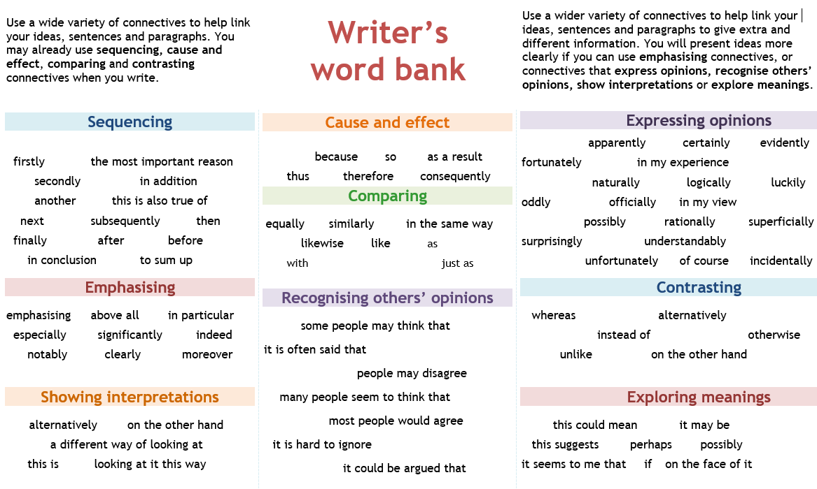

Slide 19
